Slide 1
RxJS
Mapping Returned Data
Lecture 5
By James(Jin) Wang
12/05/2021

Slide 2
Outline
Mapping an HTTP response
Mapping array elements

Slide 3
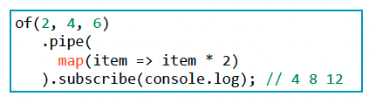
Mapping an HTTP response
  Mapping a Simple Observable

Slide 4
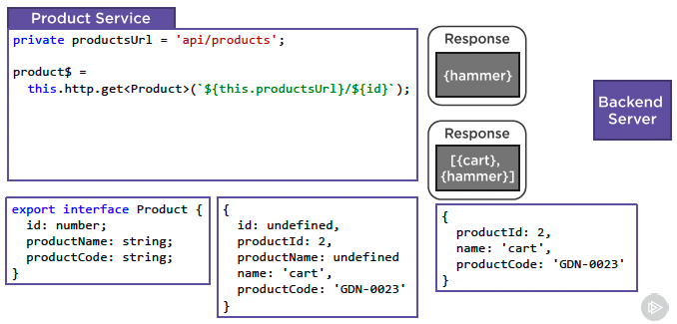
Mapping an HTTP response
  Mapping an HTTP Response

Slide 5
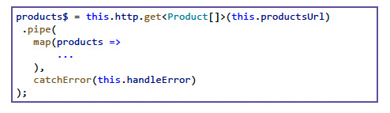
Mapping an HTTP response
  Mapping an Emitted Array
  Demo: Map Array

Slide 6
Summary

Slide 7
Assignment

Slide 8
Self Study
  RxJS: The Big Picture
  https://app.pluralsight.com/library/courses/rxjs-big-picture

